Slide 1
Deep Neural Network
AIML Module 2
Seetha Parameswaran
BITS Pilani

Slide 2
The author of this deck, Prof. Seetha Parameswaran, is gratefully acknowledging the authors who made their course materials freely available online.

Slide 3
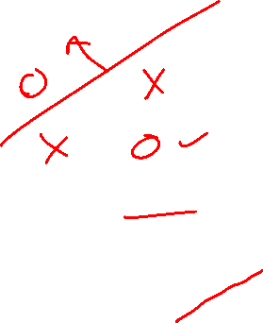
Perceptron Learning Algorithm

Slide 4
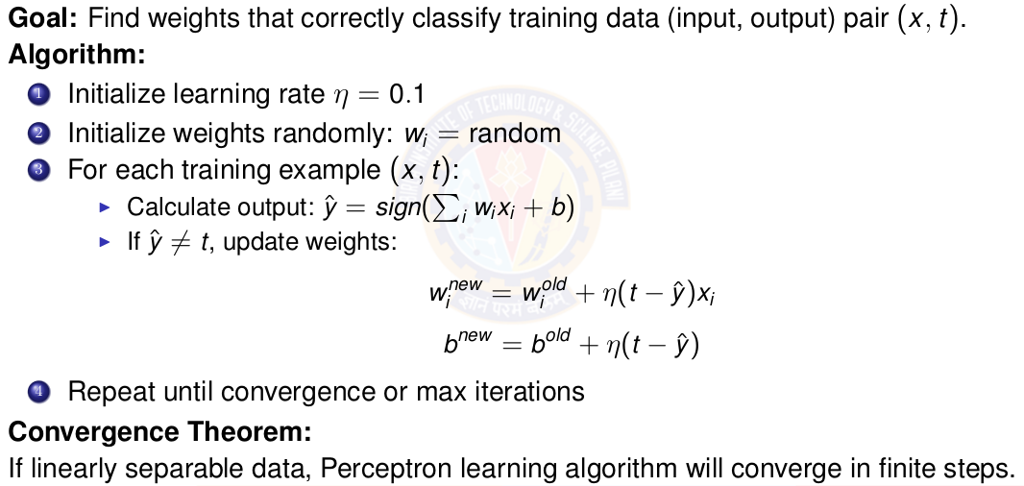
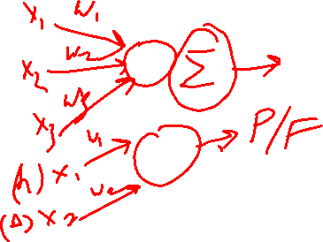
Perceptron Learning Algorithm
Notes:
Definition of learning rate is in next slide

Slide 5
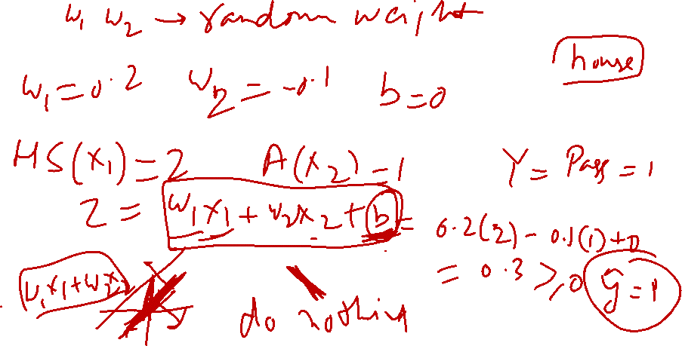

Slide 6
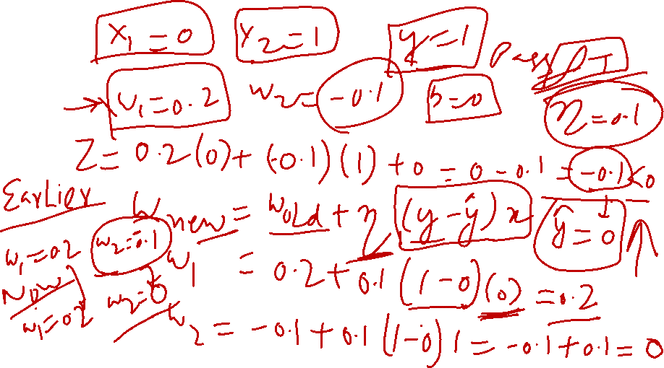

Slide 7
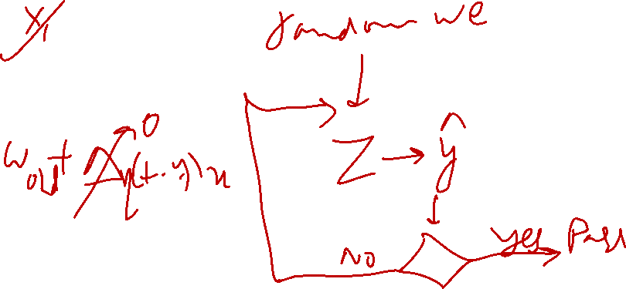

Slide 8
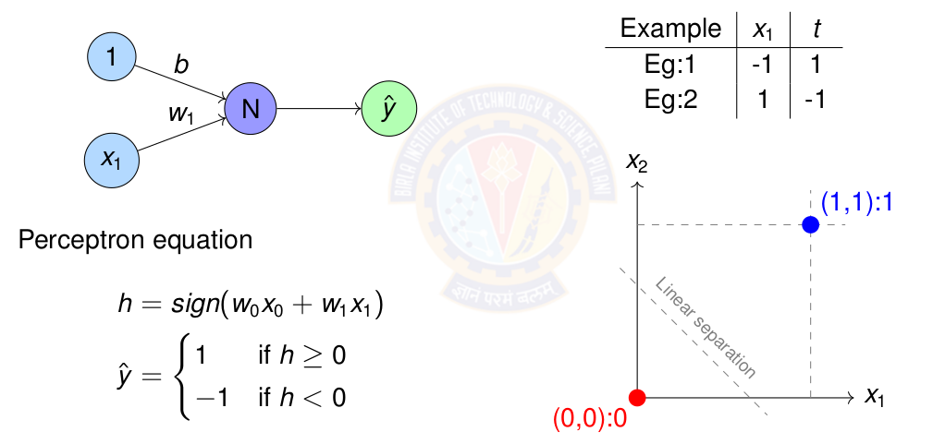
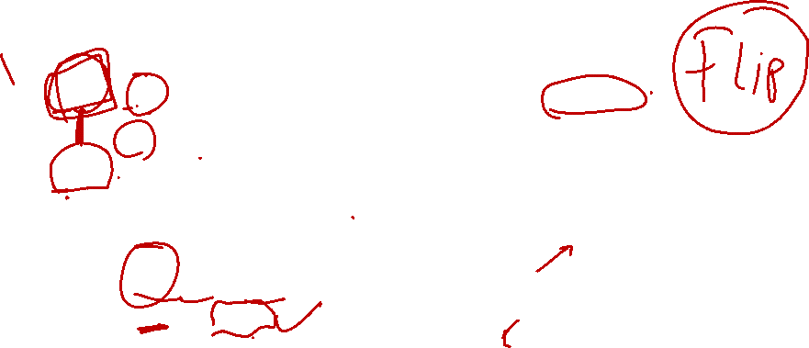
Perceptron Learning for NOT gate
Notes:
Definition of learning rate is in next slide

Slide 9
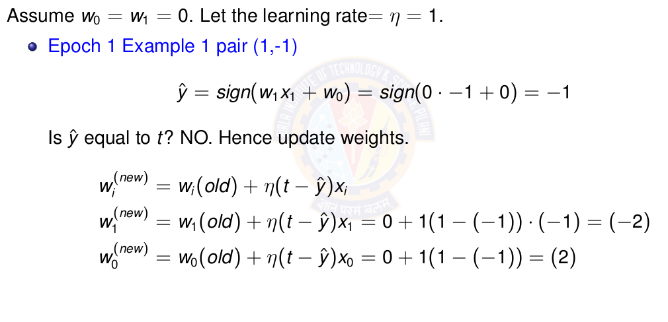
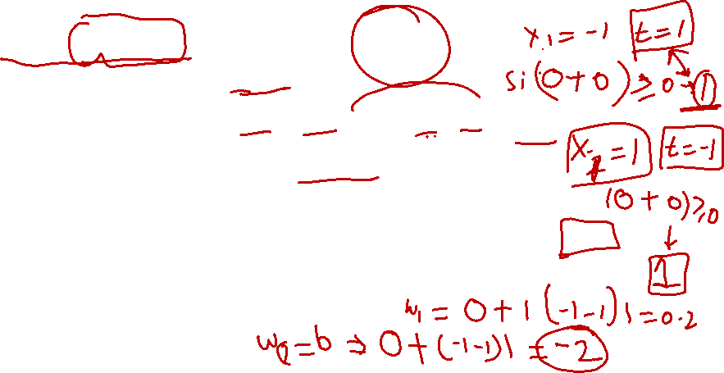
Perceptron Learning for NOT gate
Notes:
Definition of learning rate is in next slide

Slide 10
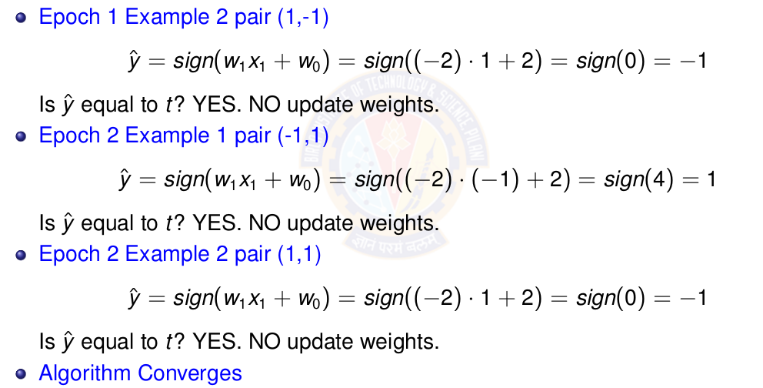
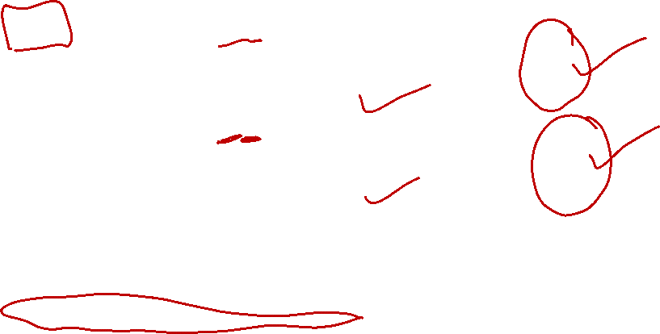
Perceptron Learning for NOT gate
Notes:
Definition of learning rate is in next slide

Slide 11
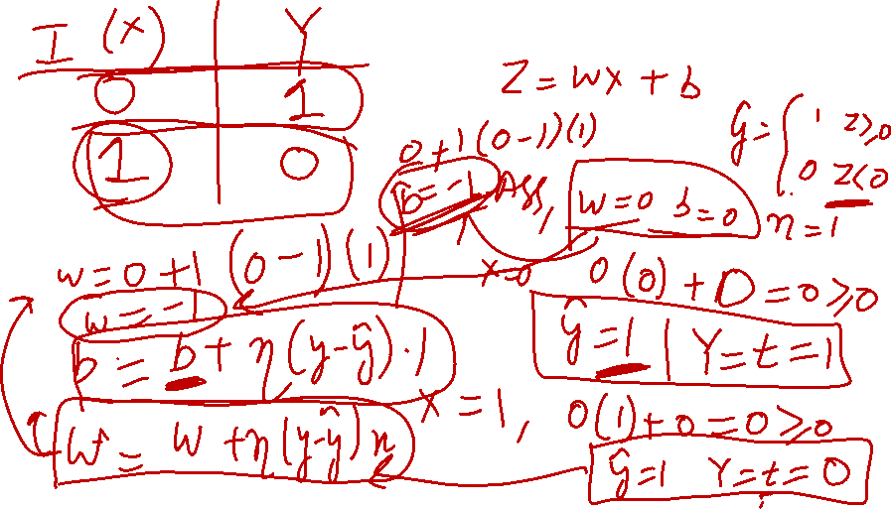



Slide 12
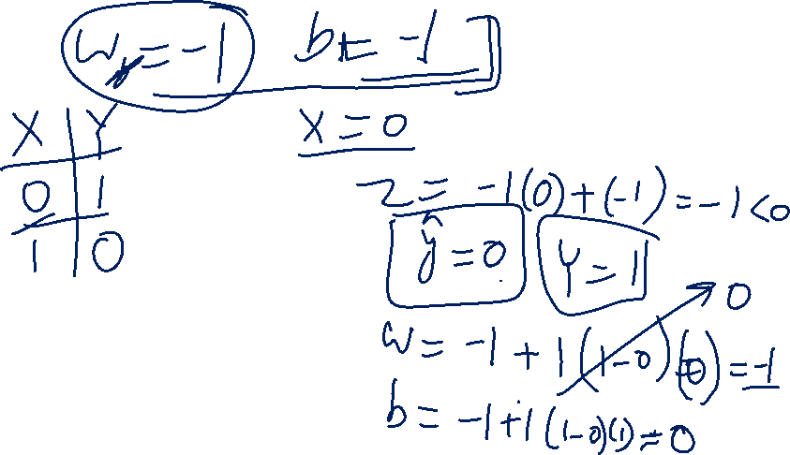

Slide 13
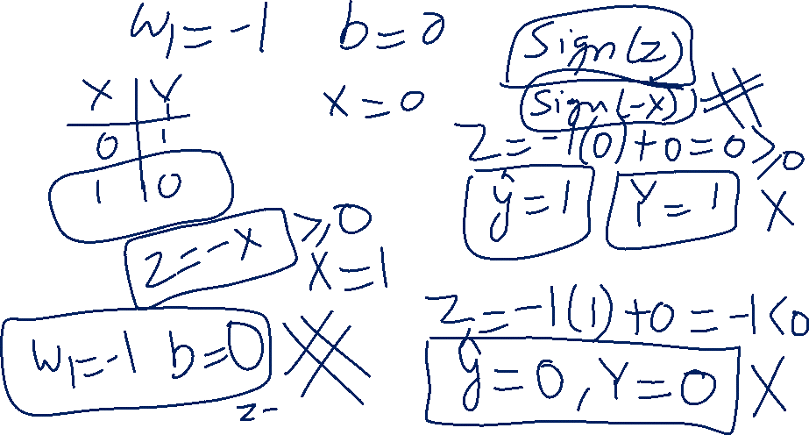

Slide 15
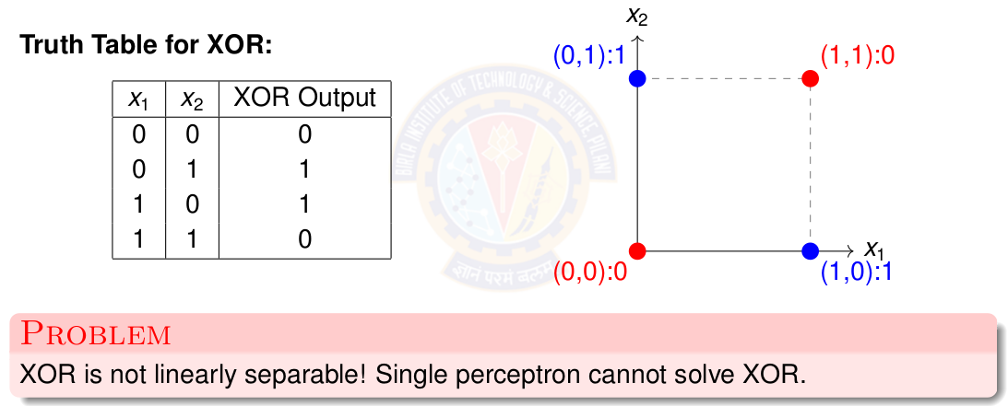

The XOR Problem
Notes:
Definition of learning rate is in next slide

Slide 16
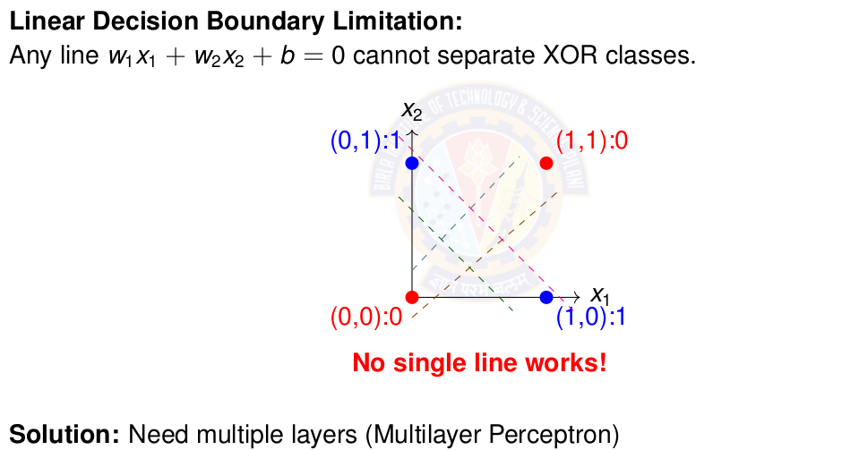

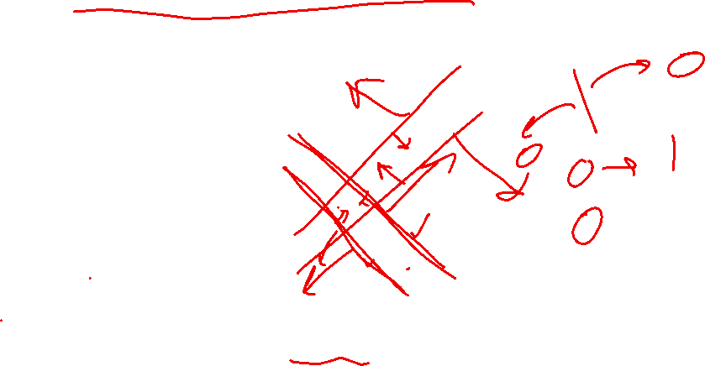
Why Single Perceptron Fails on XOR
Notes:
Definition of learning rate is in next slide

Slide 17
Perceptron Demo Python Code
https://colab.research.google.com/drive/1DUVcOoUIWhl8GQKc6AWR1wi0LaMeNkgD?usp=sharing
Student pl note:
The Python notebook is shared for anyone who has access to the link and the access is restricted to use BITS email id. So pl do not access from non-BITS email id and send requests for access.

Slide 18
Linearly Separable Data

Slide 19
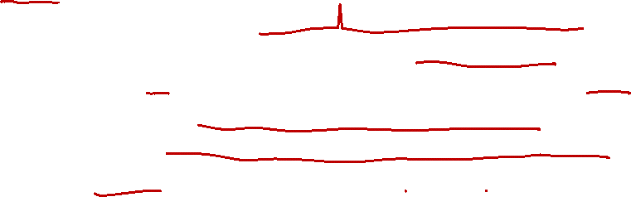
Linearly Separable Data
Two sets data points are separable in a n-dimensional space if they can be separated by an (n-1) dimensional hyperplane.
A straight line can be drawn to separate all the data examples belonging to class +1 from all the examples belonging to the class -1. Then the two-dimensional data are clearly linearly separable.
An infinite number of straight lines can be drawn to separate the class +1 from the class -1.
Notes:
Our aim to find the optimal decision boundary that can separate the classes.

Slide 20
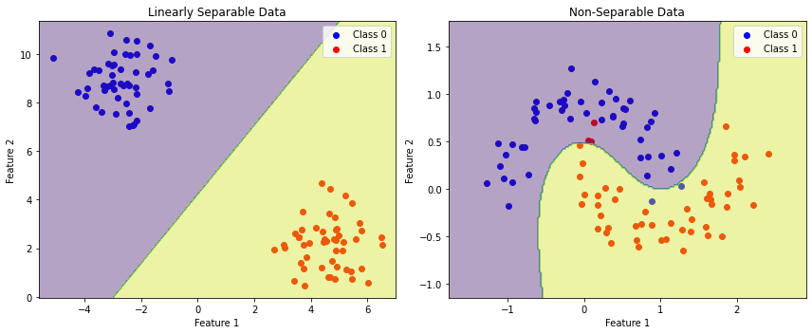
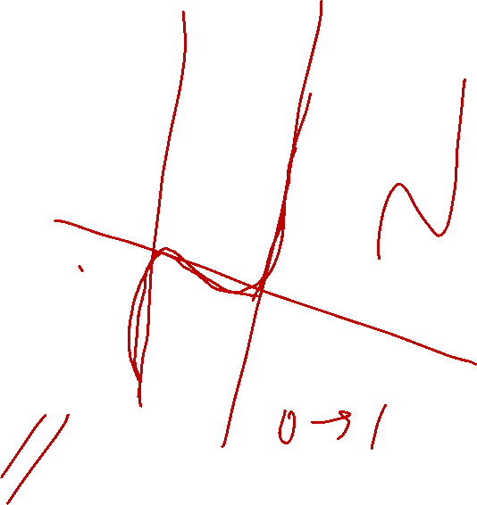
Linearly vs Non-Linearly Separable Data
Notes:
Our aim to find the optimal decision boundary that can separate the classes.

Slide 21
Perceptron for Linearly Separable Data
Data
Truth tables or set of examples
Model
Perceptron
Inputs x are the features or columns
Target output t is the required label
Objective Function
Deviation of desired output or target t and the computed output ŷ
Learning Algorithm
Perceptron Learning algorithm
Challenge
How to learn these n + 1 parameters w₀ , w₁ . w₂ . . . w_{n} ?
Solution
Use Perceptron learning algorithm.
Notes:
THe perceptron can take any number of inputs. Each input connection will have a weight associated with it. The aim is to find the values of these parameters that can draw a decision boundary that will separate the classes. The computation remind the same ie take the sign of the weighted sum and compute output response for each example.

Slide 22
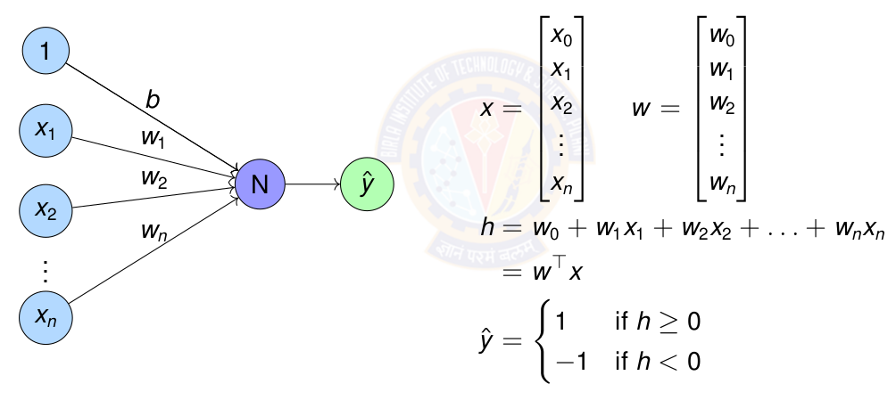
Perceptron for Linearly Separable Data
Notes:
THe perceptron can take any number of inputs. Each input connection will have a weight associated with it. The aim is to find the values of these parameters that can draw a decision boundary that will separate the classes. The computation remind the same ie take the sign of the weighted sum and compute output response for each example.

Slide 23
Exercise
Represent OR gate using Perceptron. Compute the parameters of the perceptron using perceptron learning algorithm.
Represent AND gate using Perceptron. Compute the parameters of the perceptron using perceptron learning algorithm.
Represent NOR gate using Perceptron. Compute the parameters of the perceptron using perceptron learning algorithm.
Represent NAND gate using Perceptron. Compute the parameters of the perceptron using perceptron learning algorithm.
Implement a perceptron for AND and OR gates
Sketch decision boundaries for Single perceptron
Notes:
Give this as exercise for the students.

Slide 24
Key Concepts
Neural Network: Biological inspiration and mathematical models
Perceptron: Simplest neural unit, linear classification, learning algorithm
XOR Problem: Limitation of linear models, need for hidden layers
Learning Paradigms: Supervised, unsupervised, reinforcement learning
Notes:
Give this as exercise for the students.

Slide 25
References
Zhang et al. "Dive into Deep Learning" - Chapter 1 https://d2l.ai/
http://mlsp.cs.cmu.edu/people/rsingh/docs/Chapter1_Introduction.pdf
Goodfellow, Bengio, Courville - "Deep Learning" Chapters 1-6
Rosenblatt, F. (1958) - "The Perceptron: A Probabilistic Model”
Minsky & Papert (1969) - "Perceptrons" (Historical perspective)
Thank You :)

